Slide 1

Chapter 14 (continued)
Graphs
© 2011 Pearson Addison-Wesley. All rights reserved
14 B-<number>

Slide 2
Depth-First Search
Depth-first search (DFS) traversal
  Proceeds along a path from v as deeply into the graph as possible before backing up
  Does not completely specify the order in which it should visit the vertices adjacent to v
  A last visited, first explored strategy
© 2011 Pearson Addison-Wesley. All rights reserved
14 B-<number>

Slide 3
Breadth-First Search
Breadth-first search (BFS) traversal
  Visits every vertex adjacent to a vertex v that it can before visiting any other vertex
  A first visited, first explored strategy
  An iterative form uses a queue
  A recursive form is possible, but not simple
© 2011 Pearson Addison-Wesley. All rights reserved
14 B-<number>

Slide 4
Implementing a BFS Iterator Class Using the JCF
BFSIterator class uses the ListIterator class
  As a queue to keep track of the order the vertices should be processed
BFSIterator constructor
  Initiates methods used to determine BFS order of vertices for the graph
Graph is searched by processing vertices from each vertex’s adjacency list
  In the order that they were pushed onto the queue
© 2011 Pearson Addison-Wesley. All rights reserved
14 B-<number>

Slide 5
Applications of Graphs: Topological Sorting
Topological order
  A list of vertices in a directed graph without cycles such that vertex x precedes vertex y if there is a directed edge from x to y in the graph
  There may be several topological orders in a given graph
Topological sorting
  Arranging the vertices into a topological order
© 2011 Pearson Addison-Wesley. All rights reserved
14 B-<number>

Slide 6
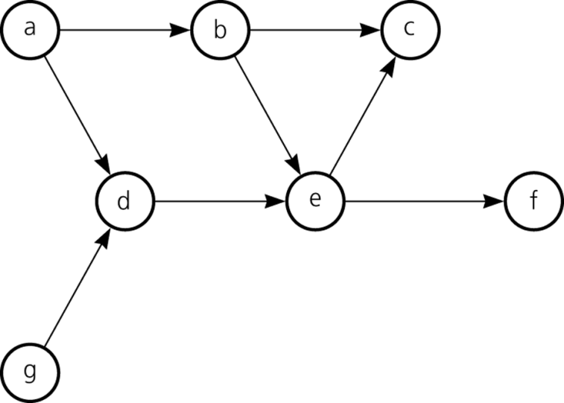
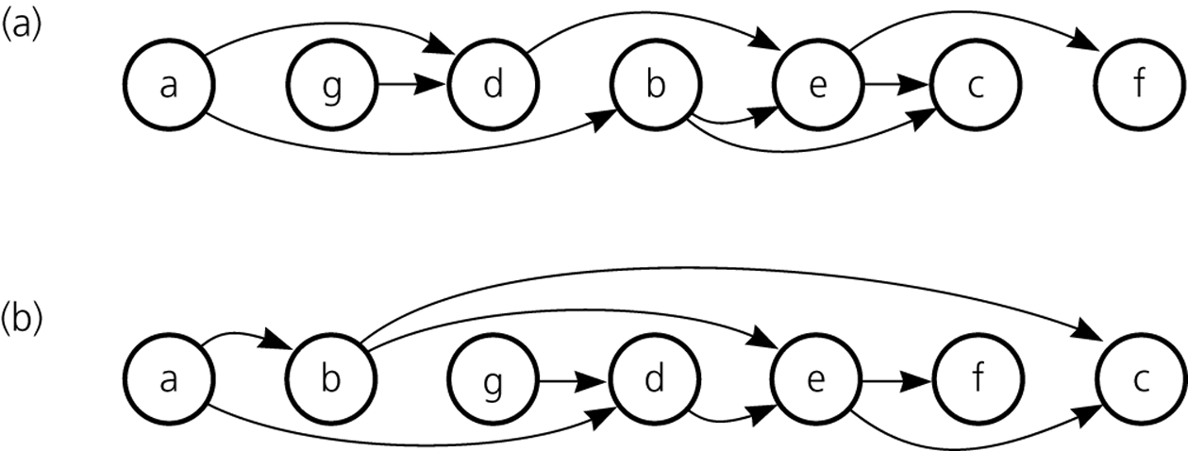
Topological Sorting
Figure 14-14
A directed graph without cycles
Figure 14-15
The graph in Figure 14-14 arranged according to the topological orders a) a, g, d, b, e, c, f and b) a, b, g, d, e, f, c
© 2011 Pearson Addison-Wesley. All rights reserved
14 B-<number>

Slide 7
Topological Sorting
Simple algorithms for finding a topological order
  topSort1
    Find a vertex that has no successor
    Remove from the graph that vertex and all edges that lead to it, and add the vertex to the beginning of a list of vertices
    Add each subsequent vertex that has no successor to the beginning of the list
    When the graph is empty, the list of vertices will be in topological order
© 2011 Pearson Addison-Wesley. All rights reserved
14 B-<number>

Slide 8
Topological Sorting
Simple algorithms for finding a topological order (Continued)
  topSort2
    A modification of the iterative DFS algorithm
    Strategy
      Push all vertices that have no predecessor onto a stack
      Each time you pop a vertex from the stack, add it to the beginning of a list of vertices
      When the traversal ends, the list of vertices will be in topological order
© 2011 Pearson Addison-Wesley. All rights reserved
14 B-<number>

Slide 9
Spanning Trees
A tree
  An undirected connected graph without cycles
A spanning tree of a connected undirected graph G
  A subgraph of G that contains all of G’s vertices and enough of its edges to form a tree
To obtain a spanning tree from a connected undirected graph with cycles
  Remove edges until there are no cycles
© 2011 Pearson Addison-Wesley. All rights reserved
14 B-<number>

Slide 10
Spanning Trees
You can determine whether a connected graph contains a cycle by counting its vertices and edges
  A connected undirected graph that has n vertices must have at least n – 1 edges
  A connected undirected graph that has n vertices and exactly n – 1 edges cannot contain a cycle
  A connected undirected graph that has n vertices and more than n – 1 edges must contain at least one cycle
© 2011 Pearson Addison-Wesley. All rights reserved
14 B-<number>

Slide 11
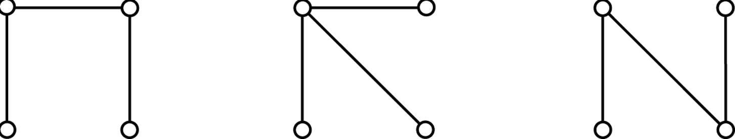
Spanning Trees
Figure 14-19
Connected graphs that each have four vertices and three edges
© 2011 Pearson Addison-Wesley. All rights reserved
14 B-<number>

Slide 12
The DFS Spanning Tree
To create a depth-first search (DFS) spanning tree
  Traverse the graph using a depth-first search and mark the edges that you follow
  After the traversal is complete, the graph’s vertices and marked edges form the spanning tree
© 2011 Pearson Addison-Wesley. All rights reserved
14 B-<number>

Slide 13
The BFS Spanning Tree
To create a breath-first search (BFS) spanning tree
  Traverse the graph using a bread-first search and mark the edges that you follow
  When the traversal is complete, the graph’s vertices and marked edges form the spanning tree
© 2011 Pearson Addison-Wesley. All rights reserved
14 B-<number>

Slide 14
Minimum Spanning Trees
Minimum spanning tree
  A spanning tree for which the sum of its edge weights is minimal
Prim’s algorithm
  Finds a minimal spanning tree that begins at any vertex
  Strategy
    Find the least-cost edge (v, u) from a visited vertex v to some unvisited vertex u
    Mark u as visited
    Add the vertex u and the edge (v, u) to the minimum spanning tree
    Repeat the above steps until there are no more unvisited vertices
© 2011 Pearson Addison-Wesley. All rights reserved
14 B-<number>

Slide 15
Shortest Paths
Shortest path between two vertices in a weighted graph
  The path that has the smallest sum of its edge weights
Dijkstra’s shortest-path algorithm
  Determines the shortest paths between a given origin and all other vertices
  Uses
    A set vertexSet of selected vertices
    An array weight, where weight[v] is the weight of the shortest (cheapest) path from vertex 0 to vertex v that passes through vertices in vertexSet
© 2011 Pearson Addison-Wesley. All rights reserved
14 B-<number>

Slide 16
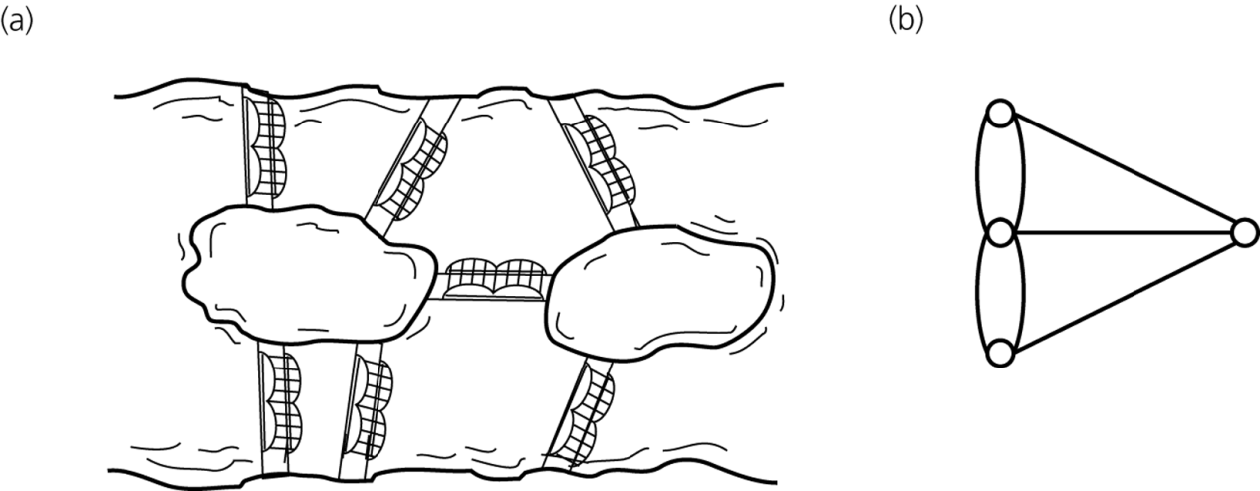
Circuits
A circuit
  A special cycle that passes through every vertex (or edge) in a graph exactly once
Euler circuit
  A circuit that begins at a vertex v, passes through every edge exactly once, and terminates at v
  Exists if and only if each vertex touches an even number of edges
Figure 14-27
a) Euler’s bridge problem and b) its multigraph representation
© 2011 Pearson Addison-Wesley. All rights reserved
14 B-<number>

Slide 17
Some Difficult Problems
Three applications of graphs
  The traveling salesperson problem
  The three utilities problem
  The four-color problem
A Hamilton circuit
  Begins at a vertex v, passes through every vertex exactly once, and terminates at v
© 2011 Pearson Addison-Wesley. All rights reserved
14 B-<number>

Slide 18
Summary
The two most common implementations of a graph are the adjacency matrix and the adjacency list
Graph searching
  Depth-first search goes as deep into the graph as it can before backtracking
  Bread-first search visits all possible adjacent vertices before traversing further into the graph
Topological sorting produces a linear order of the vertices in a directed graph without cycles
© 2011 Pearson Addison-Wesley. All rights reserved
14 B-<number>

Slide 19
Summary
Trees are connected undirected graphs without cycles
  A spanning tree of a connected undirected graph is a subgraph that contains all the graph’s vertices and enough of its edges to form a tree
A minimum spanning tree for a weighted undirected graph is a spanning tree whose edge-weight sum is minimal
The shortest path between two vertices in a weighted directed graph is the path that has the smallest sum of its edge weights
© 2011 Pearson Addison-Wesley. All rights reserved
14 B-<number>

Slide 20
Summary
An Euler circuit in an undirected graph is a cycle that begins at vertex v, passes through every edge in the graph exactly once, and terminates at v
A Hamilton circuit in an undirected graph is a cycle that begins at vertex v, passes through every vertex in the graph exactly once, and terminates at v
© 2011 Pearson Addison-Wesley. All rights reserved
14 B-<number>

